Slide 1
Blacktivists In The Archive
Presented By: Matthew Stevenson
Original Author: Ed Summers
Course: CS895
2019-03-06
Source: https://news.docnow.io/blacktivists-in-the-archive-71c807aa247e

Slide 2
Source: https://news.docnow.io/blacktivists-in-the-archive-71c807aa247e

Slide 3
Source: https://twitter.com/donie/status/913571130975252480

Slide 4
Source: https://www.theguardian.com/technology/2017/sep/30/blacktivist-facebook-account-russia-us-election

Slide 5
Source: https://www.facebook.com/photo.php?fbid=10154097683603610

Slide 6
Source: https://www.theguardian.com/technology/2017/sep/27/mark-zuckerberg-facebook-2016-election-fake-news

Slide 7
Russia Influencing American Politics
Blacktivist was a member of 470 linked Russian Facebook accounts and of 200 Twitter accounts
Source: https://news.docnow.io/blacktivists-in-the-archive-71c807aa247e

Slide 8
Source: https://thehill.com/homenews/senate/352743-senate-panel-invites-facebook-to-testify

Slide 9
But Why Blacktivist And Do These Accounts Still Exist?
Let’s Take A Look.

Slide 10
Source: https://www.facebook.com/blacktivists

Slide 11
Source: https://twitter.com/blacktivist

Slide 12
Shall We Try Another Method?
Let Us See What Twitter Returns

Slide 13
Source: https://twitter.com/search?q=%40blacktivists&src=typd

Slide 14
Source: https://twitter.com/justin_littman/status/915285234249355264

Slide 15
Source: https://gwu-libraries.github.io/sfm-ui/posts/2017-10-03-blacktivist

Slide 16
Is This Another Dead End?
Let Us See What the internet archive can tell us.

Slide 17
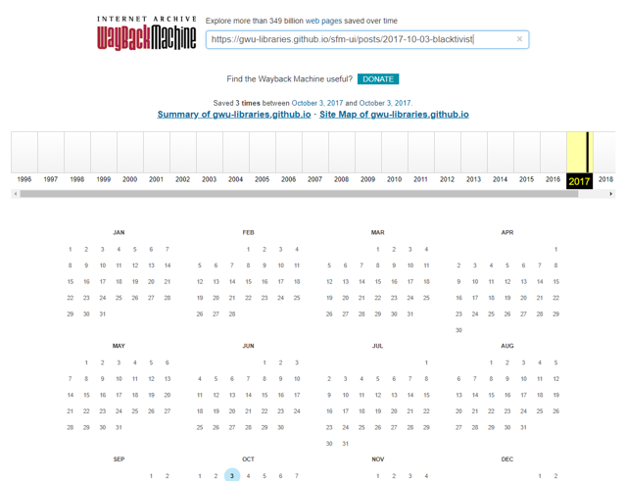
Archive Hit!
Source: https://web.archive.org/web/*/https://gwu-libraries.github.io/sfm-ui/posts/2017-10-03-blacktivist

Slide 18
Source: https://web.archive.org/web/20171003184615/https://gwu-libraries.github.io/sfm-ui/posts/2017-10-03-blacktivist

Slide 19
Source: https://dataverse.harvard.edu/dataset.xhtml?persistentId=doi:10.7910/DVN/PDI7IN

Slide 20
Based On The Dataset
For the 2016 US Presidential election Twitter Collection:
Using terms: election2016, election, Clinton, Kaine, Trump, or Pence
Or mentions: @realDonaldTrump, @HillaryClinton, @TimKaine, and @Mike_Pence
@justin_littman concludes with only 87 results, showing little or no association to @Blacktivist
Source: https://web.archive.org/web/20171003184615/https://gwu-libraries.github.io/sfm-ui/posts/2017-10-03-blacktivist

Slide 21
Blacktivist Has Essentially Vanished
But have “they” left any other footprints?

Slide 22
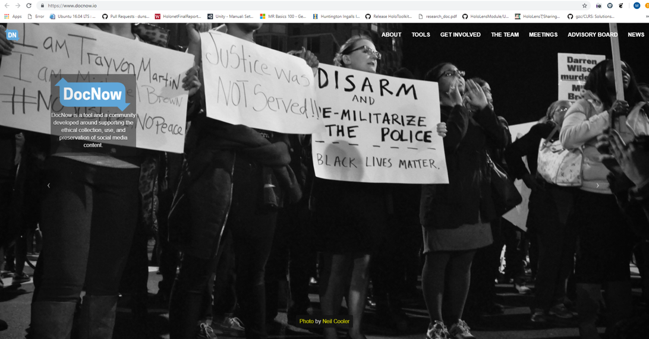
Source: https://www.docnow.io/

Slide 23
Documenting The Now
Let Us See What Was Uncovered

Slide 24
Potentially Valid Conjectures
Based on CNN reports, the use of the apostrophe was inconsistent.
“it`s” instead of “it’s”
14 tweets that used ` and 4 that used ‘
Source: https://news.docnow.io/blacktivists-in-the-archive-71c807aa247e

Slide 25
Can This Mean Multiple Authors?
Let Us Keep Going

Slide 26
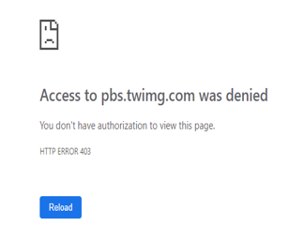
Photo Use Consistency
“98% of the tweets included a photo, all of which have been flagged as unavailable in Twitter’s image cache (HTTP Status 403)” – Ed Summers
Source: https://pbs.twimg.com/media/CrYoXmaWIAATfwm.jpg

Slide 27
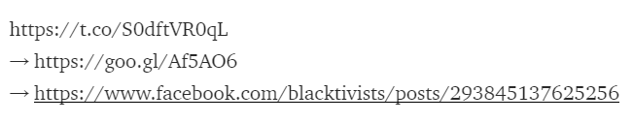
Links To Social Media
18 of the photo tweets linked to Blacktivist Facebook Account
11 used Google URL Shortener
Source: https://news.docnow.io/blacktivists-in-the-archive-71c807aa247e

Slide 28
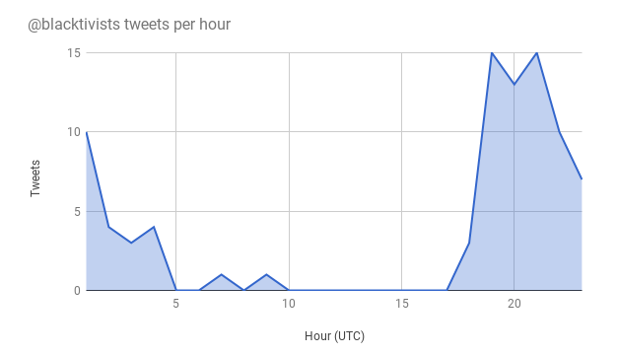
Tweets Per Hour By The Account @blacktivists
Human Workday?
Source: https://news.docnow.io/blacktivists-in-the-archive-71c807aa247e

Slide 29
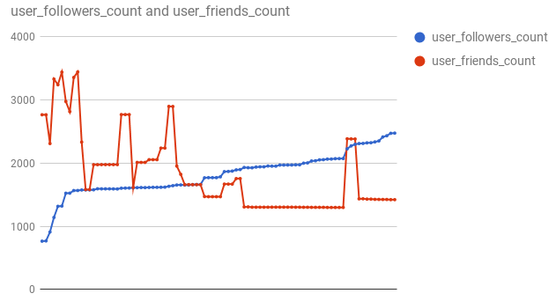
Follower And Friend Count For The Account @blacktivists
No Large Spike In Follower Or User Counts
Source: https://news.docnow.io/blacktivists-in-the-archive-71c807aa247e

Slide 30
Based On The Evidence
The Accounts Are Likely Human And Not Bots

Slide 31
The Links Between Social Media Accounts
The two social media accounts had interactions with each other and were linked in some way
The linking of accounts was based on public and private information of these two accounts
The accounts were linked to Russia based on sources
Problem:
Content created within Facebook could be abstracted from public view unless made available
Important to identify to mitigate the proper action based on evidence

Slide 32
Should We Not Have Access To This Information?
Let US ReCall…

Slide 33
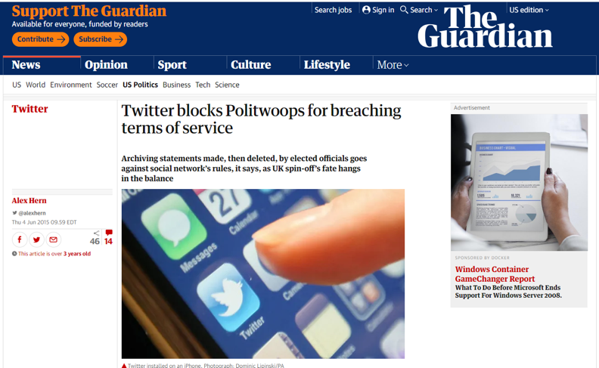
Source: https://www.theguardian.com/technology/2015/jun/04/twitter-blocks-transparency-in-government-archive-politwoops-breaching-terms-service

Slide 34
Source: https://www.nytimes.com/2016/01/01/technology/twitter-politwoops.html

Slide 35
Thoughts From The Author
Urges accounts of Blacktivist to become public record
Implies Twitter should follow suit based on Politwoops decision
Summers presents information through his project, Documenting the Now, to contribute his public service to the community

Slide 36
Concluding Remarks
Social media accounts can appear then disappear quickly leaving a lasting footprint in society
Can potential sway the outcome of a historical event
These types of accounts:
Influence public opinion
Cause public uproar
Spread misinformation
Promote an agenda

Slide 37
Contact Information:
Twitter: @mstev0du
Github: https://github.com/mst3v3nsn
Google Groups: https://groups.google.com/forum/#!forum/cs895-s19

